Slide 1
Empowering Brighton: Forecasting Surplus Energy from Solar Power
CE888-7-SP : Data Science and Decision Making
Name : Abu Junaeid Shoaib
ID: 2315853
Assessor: Dr Ana Matran-Fernandez
22/04/2024

Slide 2
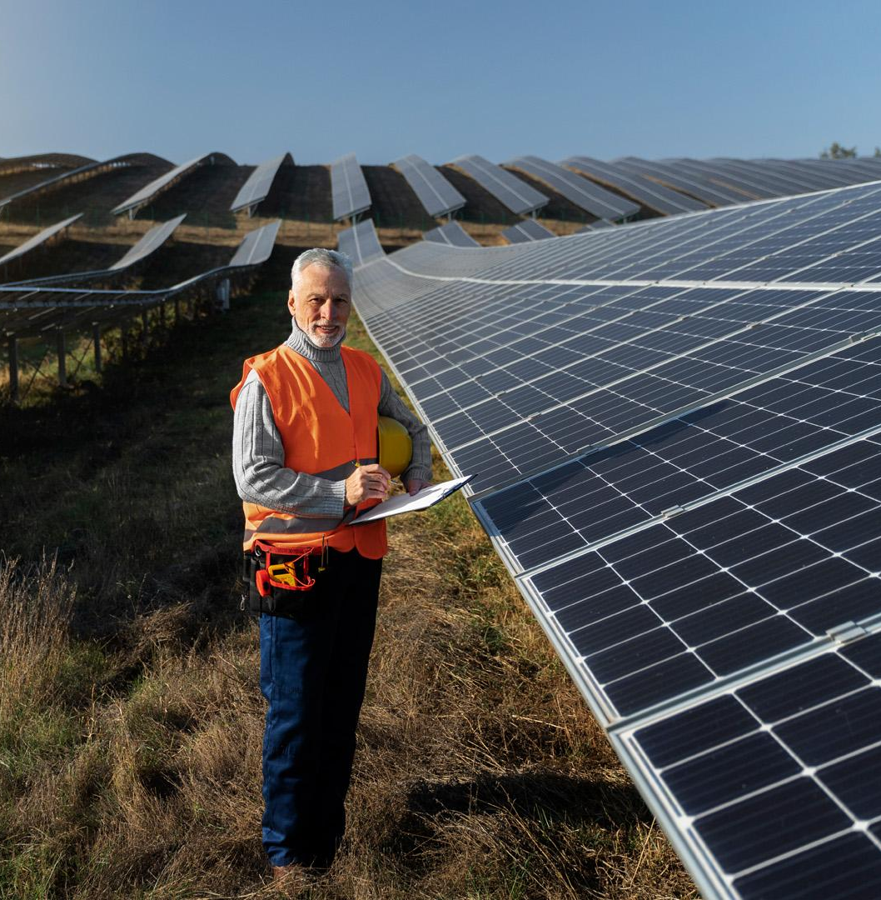
Let’s begin
Project Context As a data scientist in a forward-thinking energy company, our goal is to harness the power of renewable energy to benefit our local clients amidst rising energy costs.
Project Aim Develop a predictive system that reliably forecasts energy surplus from renewable sources at least 24 hours in advance. This will enable us to offer 'free energy slots' to customers near these sources when a surplus is expected.

Slide 3
Pilot Project Insight "Pilot Roll-out Plan: Initiate a pilot project in May 2024 to test this innovative scheme, starting with a subset of customers to evaluate the system's effectiveness.” Concerns and Challenges Minimize false positives to prevent financial losses from erroneously offering free energy. This is crucial for maintaining project viability and company sustainability.

Slide 4
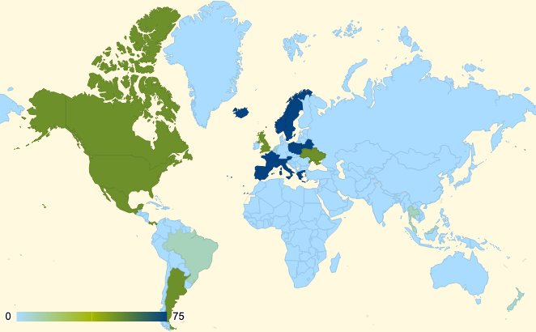
Data Exploration
Data Source
Data Utilized: Historical weather and energy data from Brighton, spanning from the year 2010 to 2023.
Data Focus
Primary Focus: Concentrated analysis on solar energy data to leverage the high potential of solar power in energy surplus prediction.
Data Processing
Handling Missing Values: Employed sophisticated methods like polynomial interpolation to ensure data integrity and reliability.
Key Variable Identification: Isolated 'solar energy' as the critical variable for forecasting energy surplus.

Slide 5
Methodology
Approach Overview
Comprehensive approach utilizing both traditional and advanced methods to ensure robustness and accuracy in predictions.
Baseline Model
Initial comparisons made with a baseline model that imitates previous year's data, setting a benchmark for improvement.
Also tried the Statistical model SARMIA
to check performence
3. Advanced Modeling
Integration of LSTM (Long Short-Term Memory) Neural Networks to capture complex patterns and dependencies in energy data.

Slide 6
Model Performance
Comparison of Models
The LSTM model significantly outperformed both the baseline and traditional statistical models,
demonstrating its efficacy in forecasting energy surplus.
Accuracy Metrics
The LSTM model achieved a Mean Absolute Error (MAE) of 0.19 for solar energy predictions,
underscoring its high precision in quantifying energy outputs.
Monthly R² Scores
Analysis of R² scores by month revealed that May, June, and September
are the most suitable months for conducting the pilot project, due to higher prediction reliability.
Baseline:
1. Solar (MAE = 0.21 MAPE = 67.98% R2 = 0.62 ). 2. Wind (MAE = 8.68 MAPE = 83.50% R2 = -0.74)
SARIMA:
1. Solar (MAE = 0.45 MAPE = 99.57% R2 = -0.36)

Slide 7
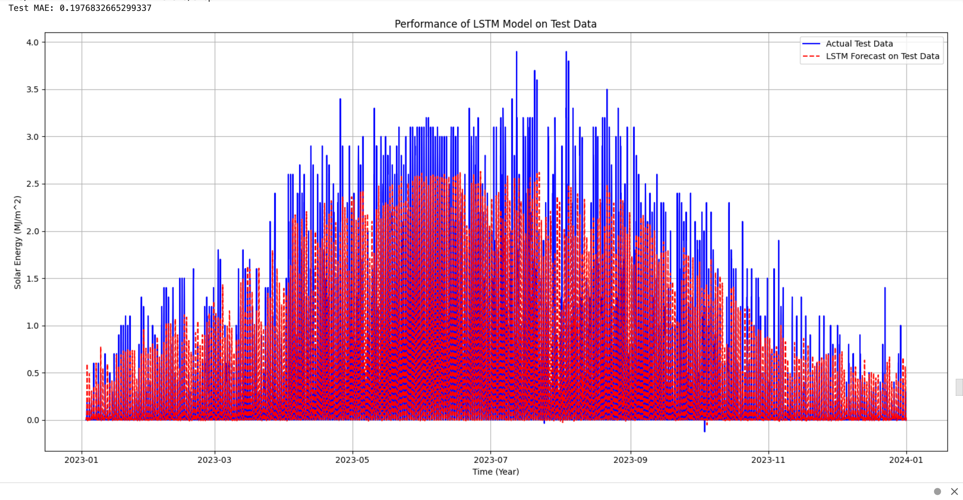
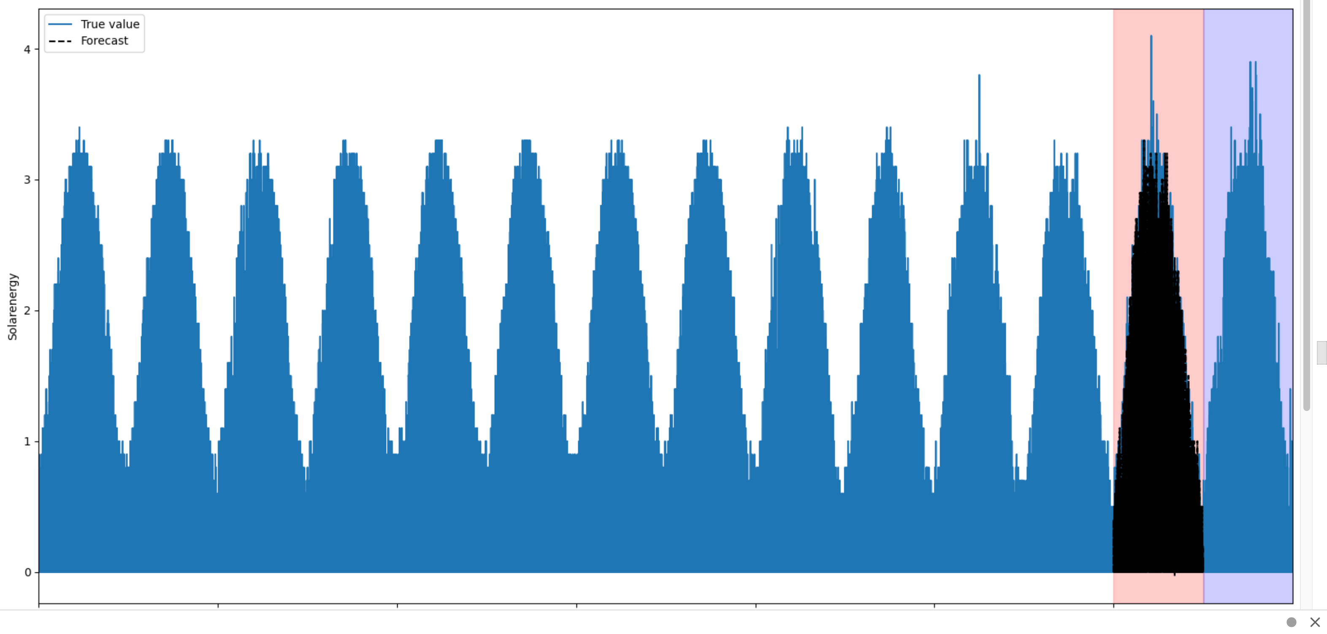
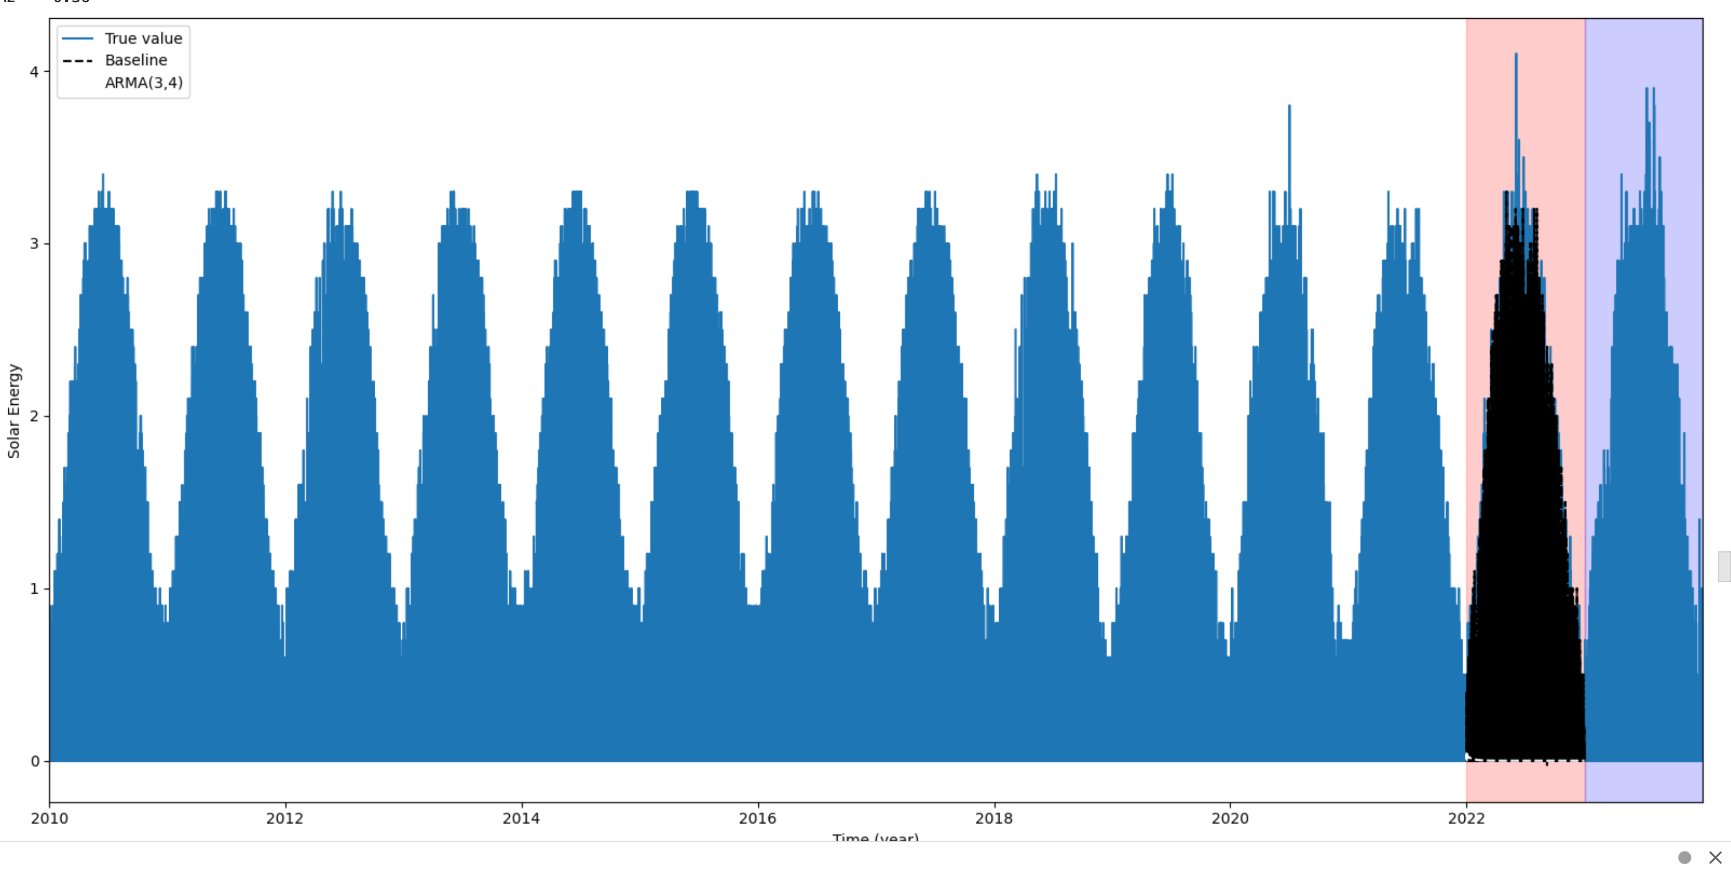
Plot showcase
2
1
3
LSTM
Baseline
SARIMA

Slide 8
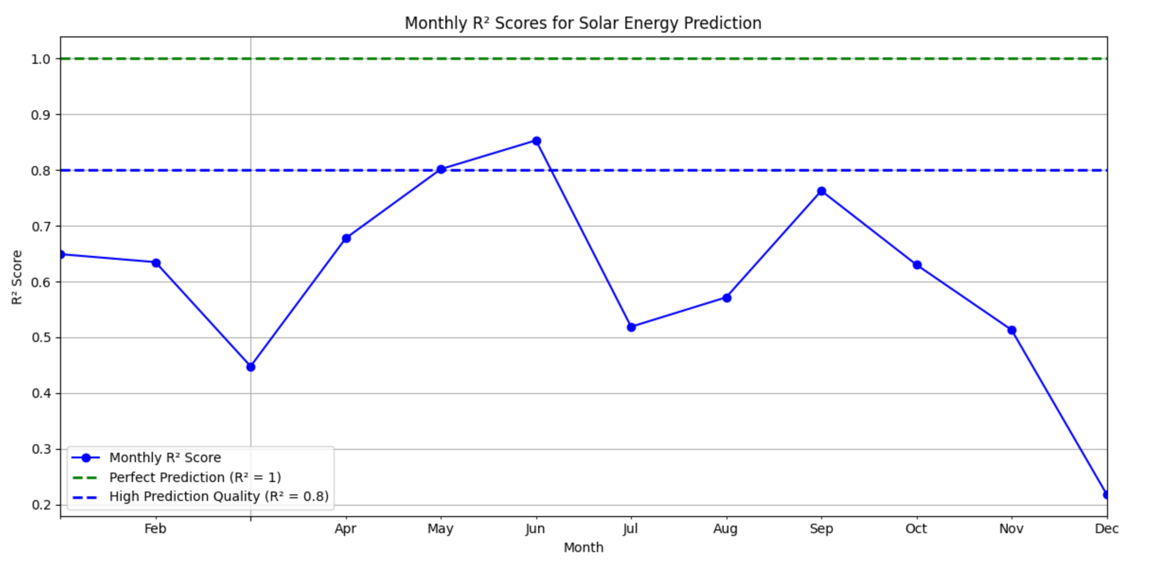
R2 Plot for Deployment

Slide 9
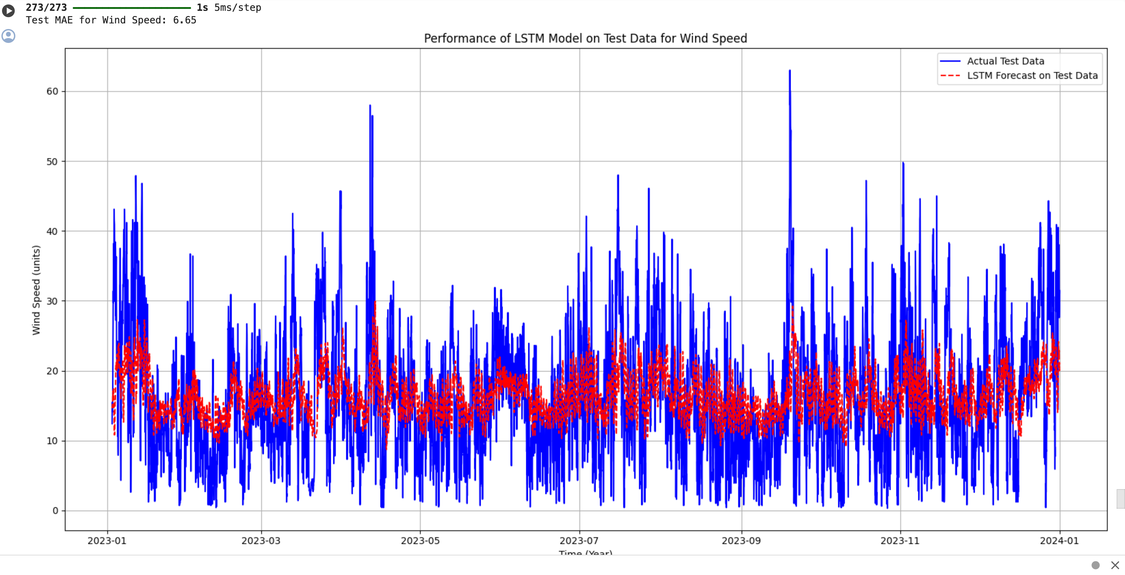
Wind Speed

Slide 10
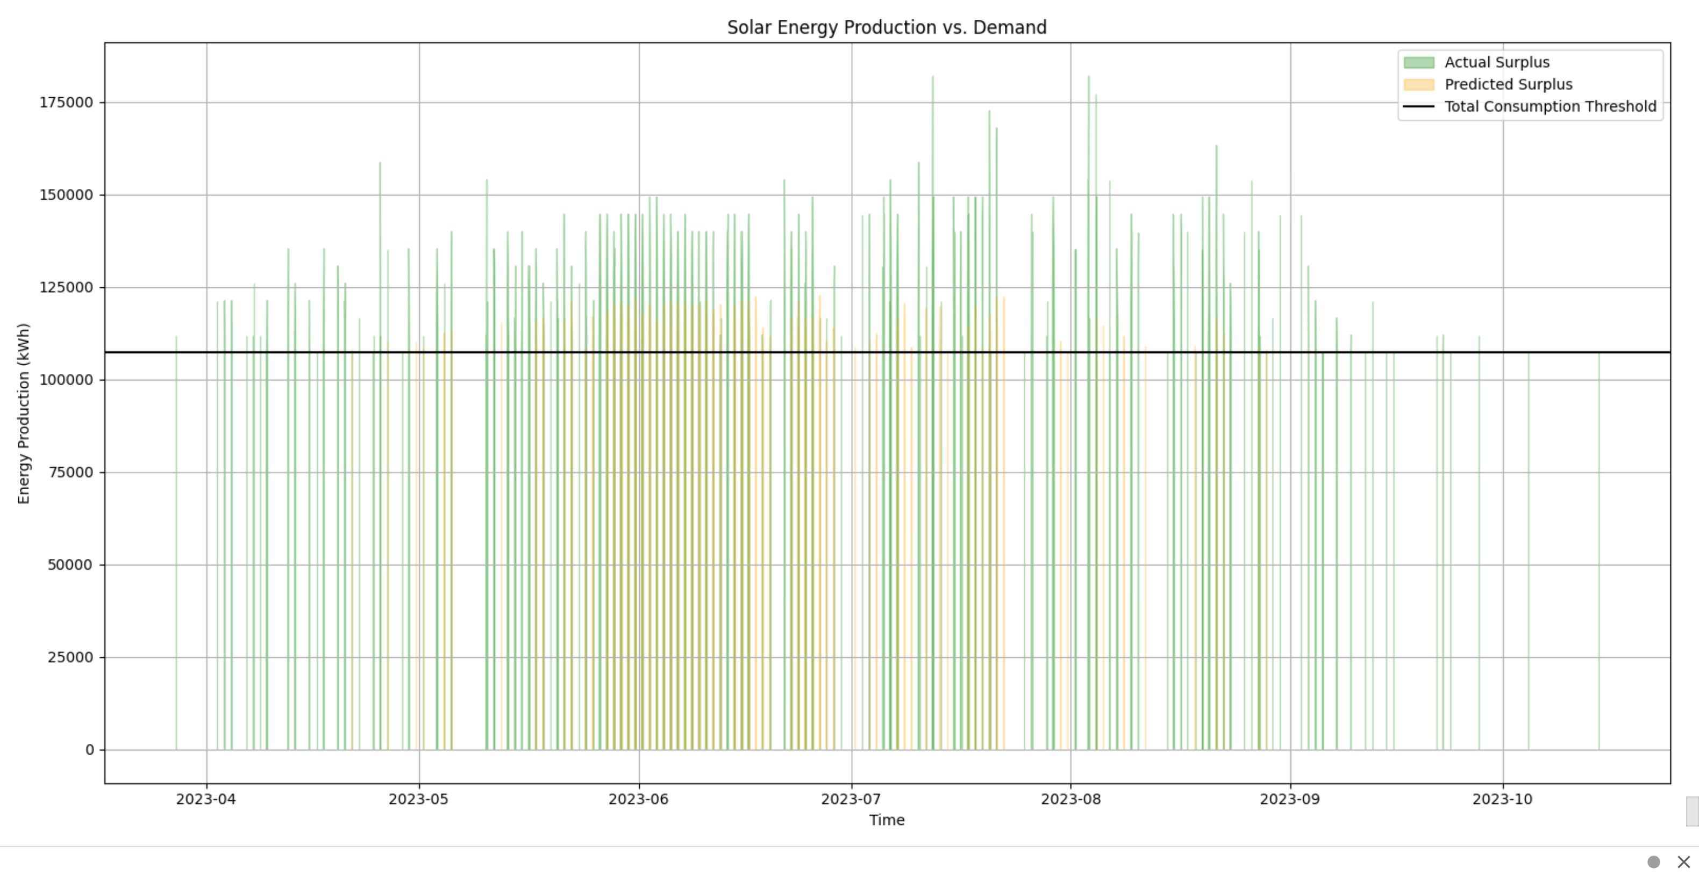
Economic Impact of False Positives
Financial Analysis:
Detailed analysis on the potential financial repercussions of false positives in energy surplus predictions.
Total cost per year incurred due to incorrect surplus predictions: £92576.63

Slide 11
Conclusions and Future Work
Key Takeaways:
The LSTM model is reliable for forecasting solar energy surplus.
Recommendations for operational deployment.
Future enhancements: Include wind energy predictions.

Slide 12
Resources
# Average consumtion or need of household in Brighton (114479*7.5= 8,58,592.5 kW/day = 25757775 kw/month) (1 MJ = 0.277778 kWh)
# For day usage,lets assume 2/3 of the electricity is being used
# For nightly usage, if we make an assumption that night time (considered as the hours of darkness where
# lights and certain appliances might be used more) is approximately 1/3 of the day
# how many household are there in Brighton? ---there are 114479 .
# reference1: https://www.brighton-hove.gov.uk/sites/default/files/migrated/subject/inline/downloads/citystats/4_Housing.pdf
# Average Electricity consumtion per day? ---7.5 kW/day
# reference2: https://www.ovoenergy.com/guides/energy-guides/how-much-electricity-does-a-home-use
# reference3: https://www.homebuilding.co.uk/advice/how-many-solar-panels-do-I-need (For 250 kW a month wide 1m and 1.6 tall = 1.6 m2)
# { (1.6* (35774.6875*30))/250 = 6868.74 m2 } panal needed
# For wind energy
#reference4: https://www.e-education.psu.edu/emsc297/node/649#:~:text=The%20power%20in%20the%20wind%20at%206%20m%2Fs%20is,kW%20(8%20times%20as%20large)
# Wind energy = 1/2 * p * A * v
# Where p = density (standard 1.225 kg/m3), A = (The turbine has a 24 m diameter, which means the radius is 12 m)
# v = wind speed given in dataset
# There more the speed the more power it will generate

Slide 13
Thank you
"Harnessing the invisible power of today to illuminate the path of tomorrow."

